Slide 1
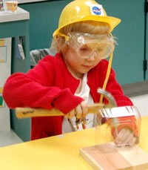
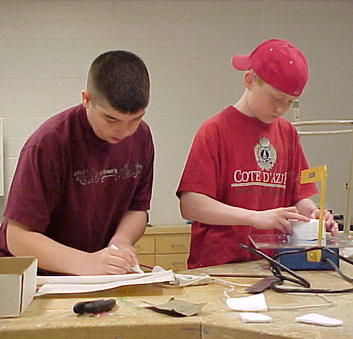
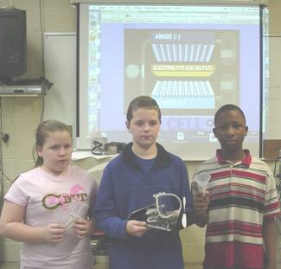
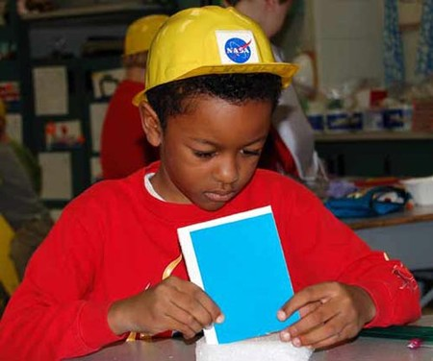



Foundations of Technology
Creativity Engagement
Teacher Resource – Day 5.1
© 2016 International Technology and Engineering Educators Association
STEM Center for Teaching and Learning™
Foundations of Technology
Notes:
© International Technology Education Assoc
Slide #<number>
12/01/2009
STEMCenter for Teaching & Learning™ Engineering byDesign™

Slide 2

The BIG Idea
Big Idea:
Creativity is a major factor in creating inventions and developing innovations.
© 2016 International Technology and Engineering Educators Association
STEM Center for Teaching and Learning™
Foundations of Technology
Notes:
[Authors: Please include teacher notes appropriately.]
© International Technology Education Assoc
Slide #<number>
12/01/2009
STEMCenter for Teaching & Learning™ Engineering byDesign™

Slide 3
The Engineering Design Journal
Take a look at the following picture. There is a man holding a block of wood in his hand.
What happens to the
log when the man
opens his hand?
© 2016 International Technology and Engineering Educators Association
STEM Center for Teaching and Learning™
Foundations of Technology
Notes:
[Authors: Please include teacher notes appropriately.]
© International Technology Education Assoc
Slide #<number>
12/01/2009
STEMCenter for Teaching & Learning™ Engineering byDesign™

Slide 4
The Engineering Design Journal
The correct answer will depend on where the man is physically located.
© 2016 International Technology and Engineering Educators Association
STEM Center for Teaching and Learning™
Foundations of Technology
Notes:
[Authors: Please include teacher notes appropriately.]
© International Technology Education Assoc
Slide #<number>
12/01/2009
STEMCenter for Teaching & Learning™ Engineering byDesign™

Slide 5
The Engineering Design Journal
If the man is standing on the ground...the block of wood will FALL DOWN due to gravity.
© 2016 International Technology and Engineering Educators Association
STEM Center for Teaching and Learning™
Foundations of Technology
Notes:
[Authors: Please include teacher notes appropriately.]
© International Technology Education Assoc
Slide #<number>
12/01/2009
STEMCenter for Teaching & Learning™ Engineering byDesign™

Slide 6
The Engineering Design Journal
If the man is under water...the log will FLOAT because its specific weight is lower than water.
© 2016 International Technology and Engineering Educators Association
STEM Center for Teaching and Learning™
Foundations of Technology
Notes:
[Authors: Please include teacher notes appropriately.]
© International Technology Education Assoc
Slide #<number>
12/01/2009
STEMCenter for Teaching & Learning™ Engineering byDesign™

Slide 7
The Engineering Design Journal
If the man is in space...the block of wood will NOT MOVE because it is not subject to any force.
© 2016 International Technology and Engineering Educators Association
STEM Center for Teaching and Learning™
Foundations of Technology
Notes:
[Authors: Please include teacher notes appropriately.]
© International Technology Education Assoc
Slide #<number>
12/01/2009
STEMCenter for Teaching & Learning™ Engineering byDesign™

Slide 8
Why We Explore
The most common answer is that the log will fall down on the ground: this is actually suitable for most situations.
This test shows how easy it is to give the most obvious answer and thus ignore possible alternatives.
© 2016 International Technology and Engineering Educators Association
STEM Center for Teaching and Learning™
Foundations of Technology
Notes:
[Authors: Please include teacher notes appropriately.]
© International Technology Education Assoc
Slide #<number>
12/01/2009
STEMCenter for Teaching & Learning™ Engineering byDesign™

